Slide 1

Principle of management
presentation
By- The Informants
MGT 201
Section-04
Assigned by- Dr. Nazmunnessa Mahtab

Slide 2
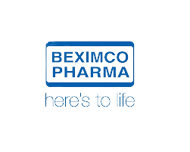
Company Overview-
In Bangladesh, Beximco Pharmaceuticals Limited is a prominent pharmaceutical manufacturer and exporter. In 1976, the firm began by importing and marketing goods from Bayer and Upjohn in Germany and the United States, respectively. Beximco Pharma began manufacturing these drugs under license in 1980, and the company formed its own formulation names in 1983. Since that humble beginning, Beximco Pharma has grown from strength to strength.

Slide 3

PESTLE analysis
political
Economical
-Federal state local laws
-Global laws
-Friendly relation with the government
Inflation changes-
Disposable Income-
Stock market fluctuations-
Social
Technology
-Demographic transition
-Population rise steadily
-Beneficial to the industry
Fast disrupting Industry-
well developed R & D Facility-
Continue innovation-

Slide 4

Legal
Environmental
-High Employment
-Benefits to workers
-Ontime Salary & Wages
-Healthy and Safe workplace for the employs
-Promoting environmental excellence (EHS Standard)

Slide 5
Specific environment
competitors | supplier | customer
Novartis | The API and formulation units of Beximco's penicillin | The target customers of Beximco are mainly doctors and patients
Cipla Limited | are located independently at Kaliakoir,
Ranbaxy Laboratories Limited | 21 kilometers from the main plant. | as the companies cover a mass market
Teva Pharmaceutical Industries Limited

Slide 6
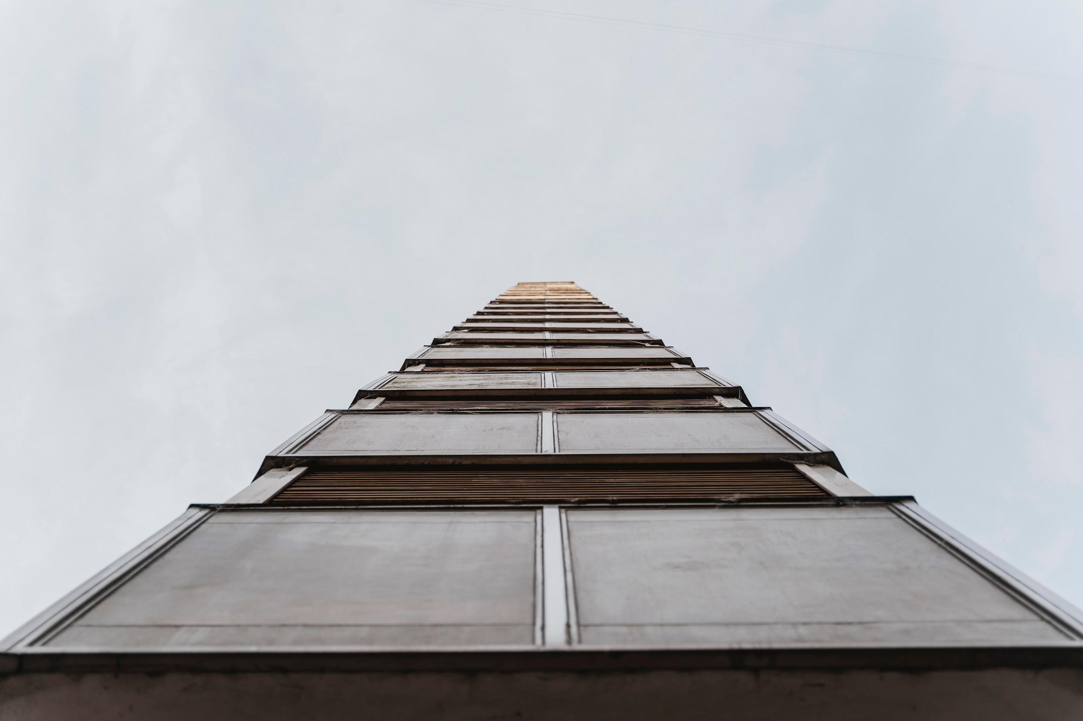
SWOT ANALYSIS-
Strengths
S
W
Weaknesses
1
2
-Delay in supplying products
-Dependency on foreign market
- Strong competitors like square
55% revenue comes from export-
400 Unique products-
Have renowned name in foreign- market 200 generic products
Have long list in research-
O
T
Opportunities
3
Threats
4
Enormous growth-
Globally certified company-
-Environment degradation
-New entrants in the market
-Huge competition

Slide 7

Stakeholder of beximco pharma
Bank Institution
Hospital
Shareholders
Employees

Slide 8
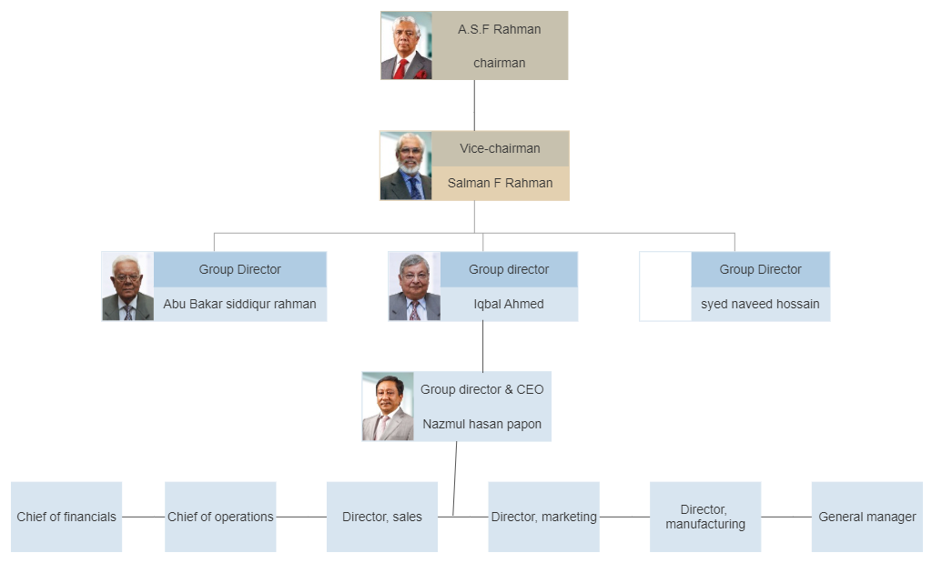
organogram

Slide 9

Structure :mechanistic
The organizational structure of Beximco is mechanistic. A mechanistic organization is one that has centralized leadership, departmental divisions, and specialized tasks that work independently of one another.
The company has a three-tier management structure comprising the board, the executive committee and the Management Committee. Certain members sit on more than one body. The board is the highest level of authority within the company comprising mainly non-executive directors. The board meets with the Executive Committee, comprising six executive directors, twice a year to conduct a full review of the company’s operations. The executive committee meets on a quarterly basis and its scope of work includes: business reviews, budget approval; and senior management appraisal.

Slide 10

Leadership:autocratic.
By studying the organogram we get to know it follows the mechanistic structure, so it has centralized leadership and managerial decisions that need to be done by higher division. Since beximco Ltd. is a pharmaceutical company, it has specialized tasks. So, For long-term decision making and to make the correct use of the employee's autocratic leadership

Slide 11
Our team
Tanaj Boshry Mithee
Shoaib Bin Rashid
Fariha Islam
ID- 2121021
Dept- BBA
ID- 2110102
Dept- BBA
ID- 1922005
Dept- BBA
Morsalin Afra Zahan
Mohammad Faiyaz Uz Zaman
Mirza Tajmari Rowshan
ID- 2222676
Dept- BBA
ID- 2130070
Dept- CSE
ID- 2130232
Dept- BBA

Slide 12

Thanks!
Do you have any questions?

